Slide 1
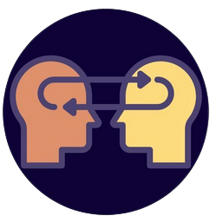
Rise of Transfer Learning Atlanta Undergradute Research Mathematics Seminar, Emory University, Nov 4, 2022
Dr. Erdi Kara
Spelman College, Mathematics

Slide 2
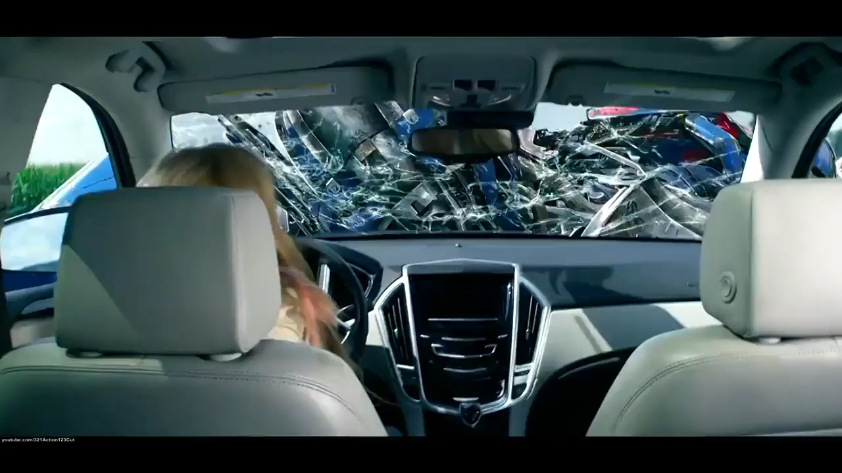
Trouble with loyalty to the cause is that the cause will always betray you…
Notes:
Where we are? Is this a hype or a real breakthrough?

Slide 3
Outline
How do machines algorithm learn?
Transfer Learning
Examples
YOLO
Stable Diffusion
GPT3
Whisper
Notes:
Very logical conversation

Slide 4
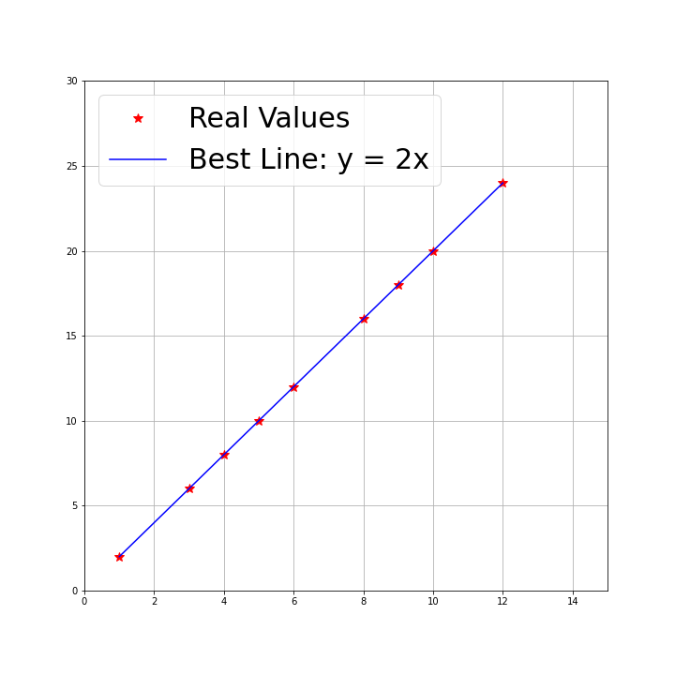
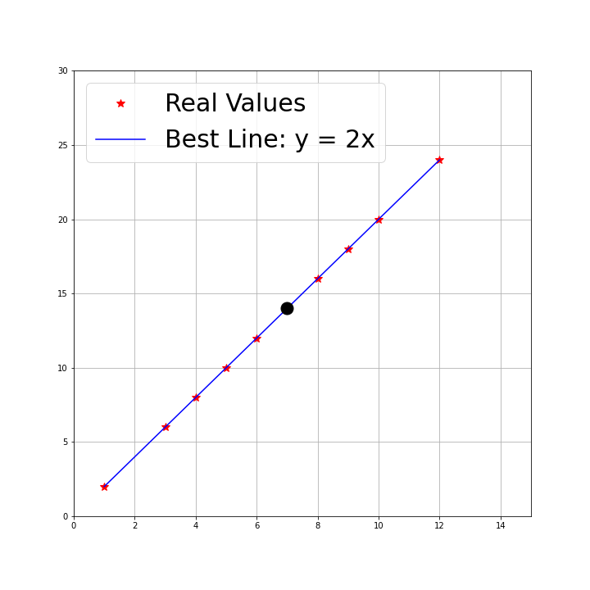
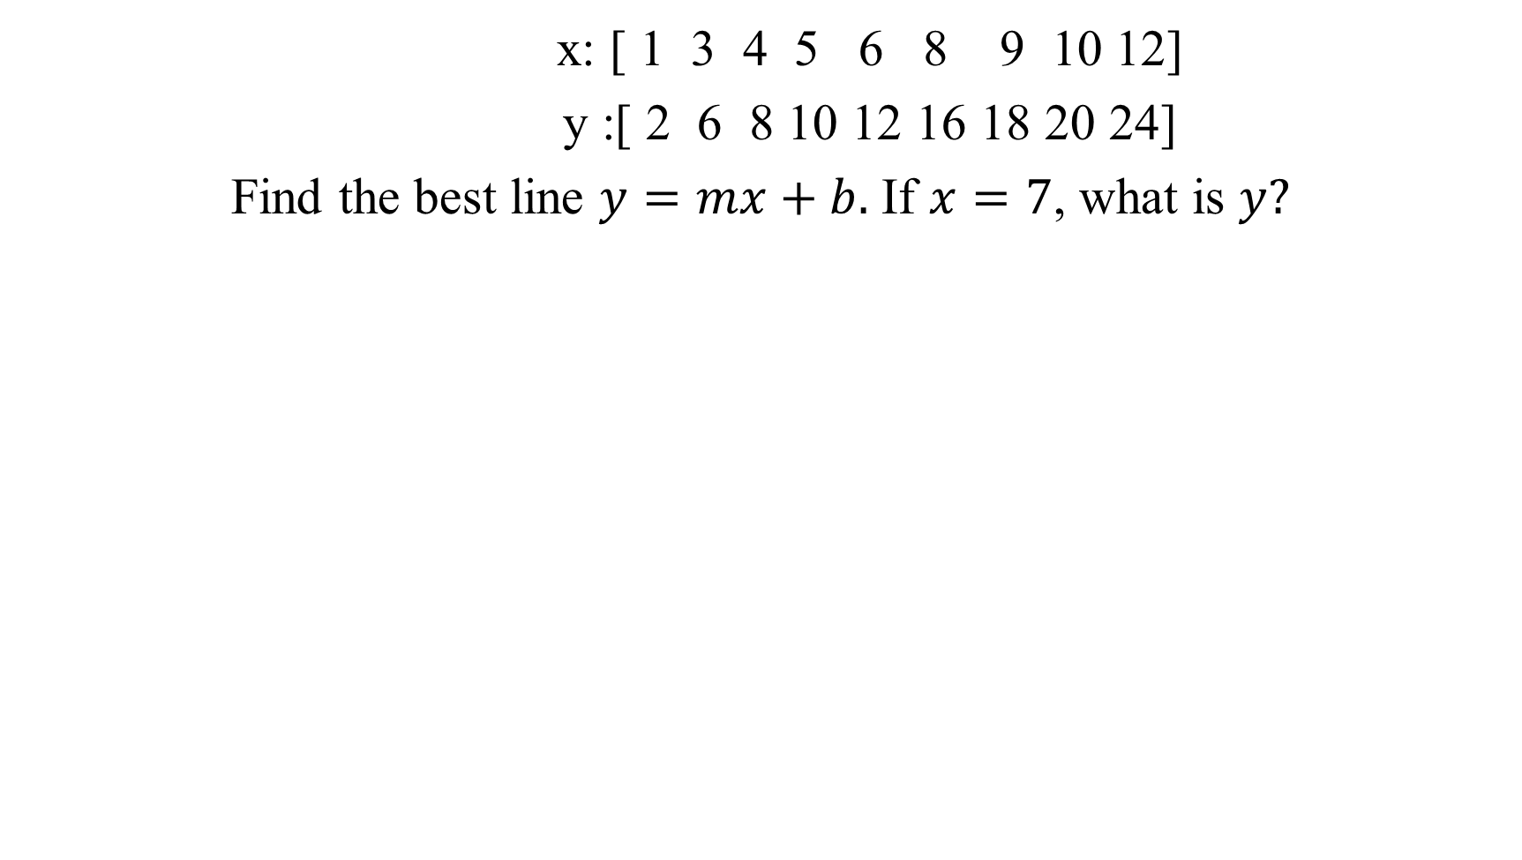
x: [ 1 3 4 5 6 8 9 10 12]
y :[ 2 6 8 10 12 16 18 20 24]
Find the best line $y=mx+b.$ If $x=7$, what is $y?$

Slide 5
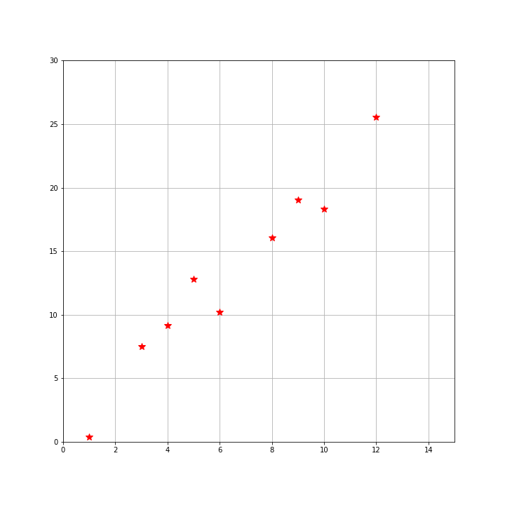
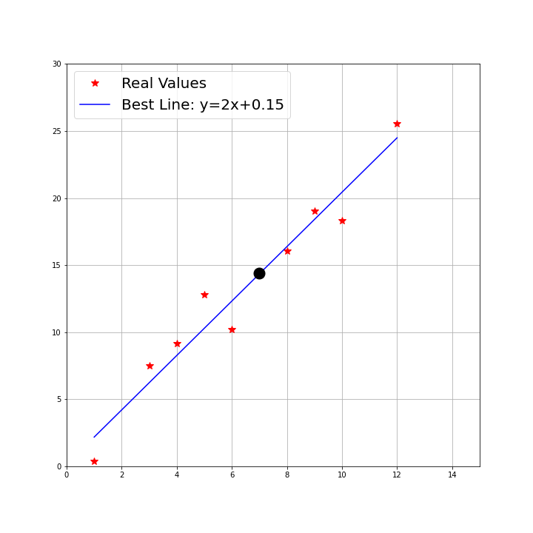
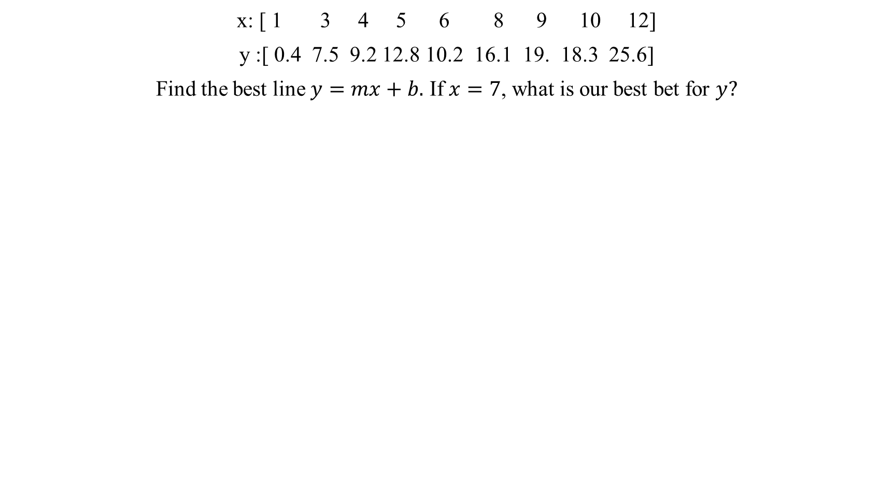
x: [ 1 3 4 5 6 8 9 10 12]
y :[ 0.4 7.5 9.2 12.8 10.2 16.1 19. 18.3 25.6]
Find the best line $y=mx+b.$ If $x=7$, what is our best bet for $y?$

Slide 6
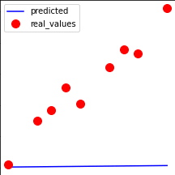
How did the algorithm learn m and b? Function approximation!

Slide 7
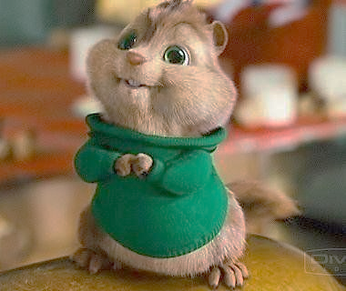
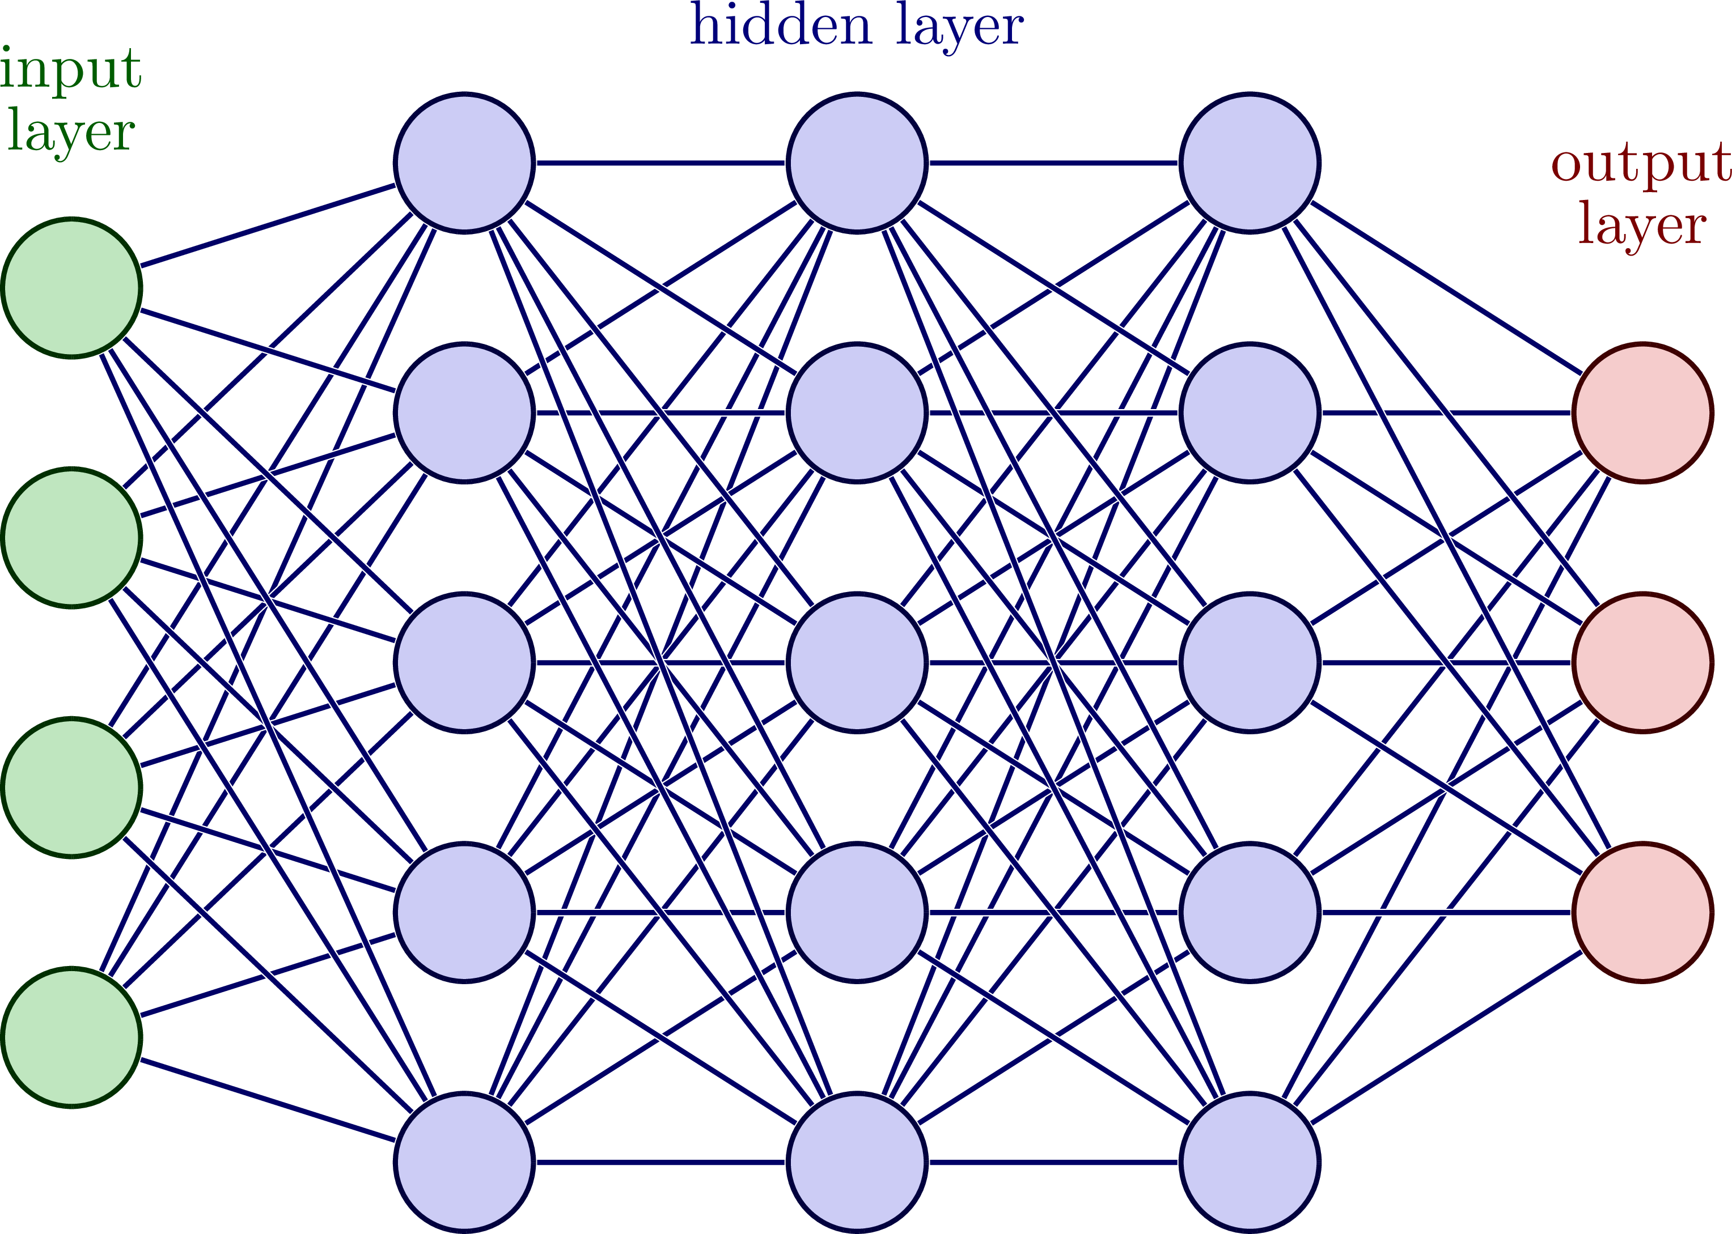
Chipmunk: 0.92
Squirrel: 0.5
Moose: 0.2
Human: 0.1
MODEL
(FUNCTION)
160,000 parameters
How many data points are there?
How many parameters should my model have? A lot…
Do not reinvent the wheel, just borrow the model from someone(:

Slide 8
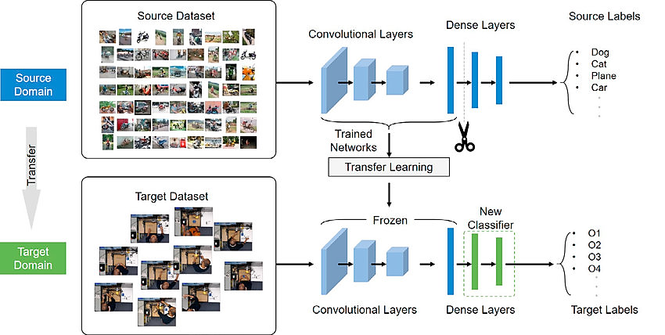
Transfer Learning: AI by the people, for the people

Slide 9
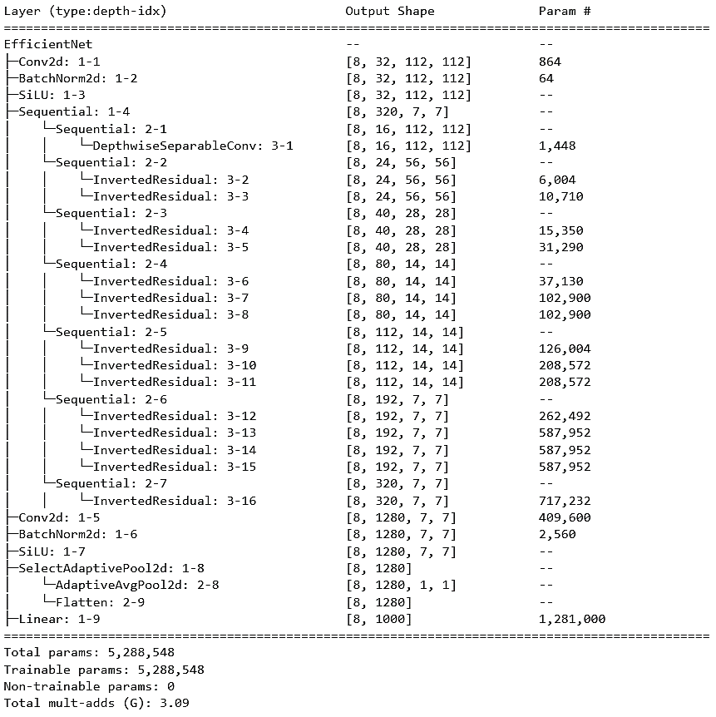
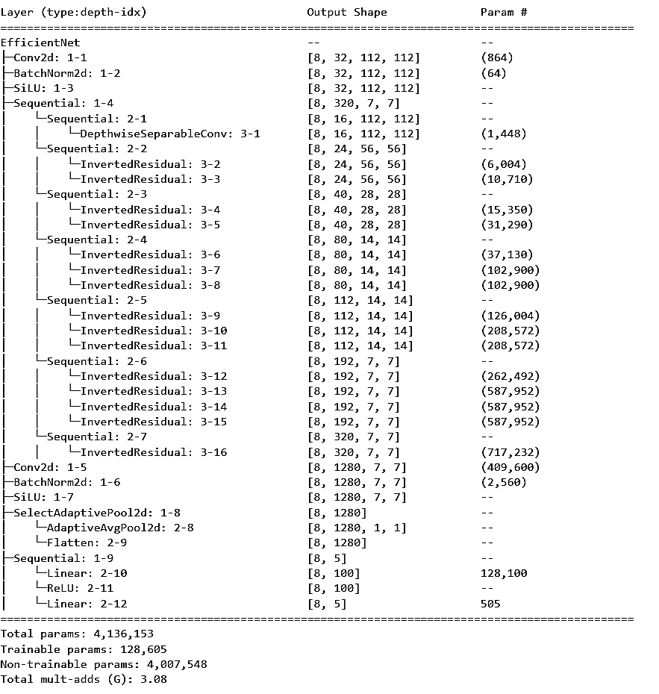
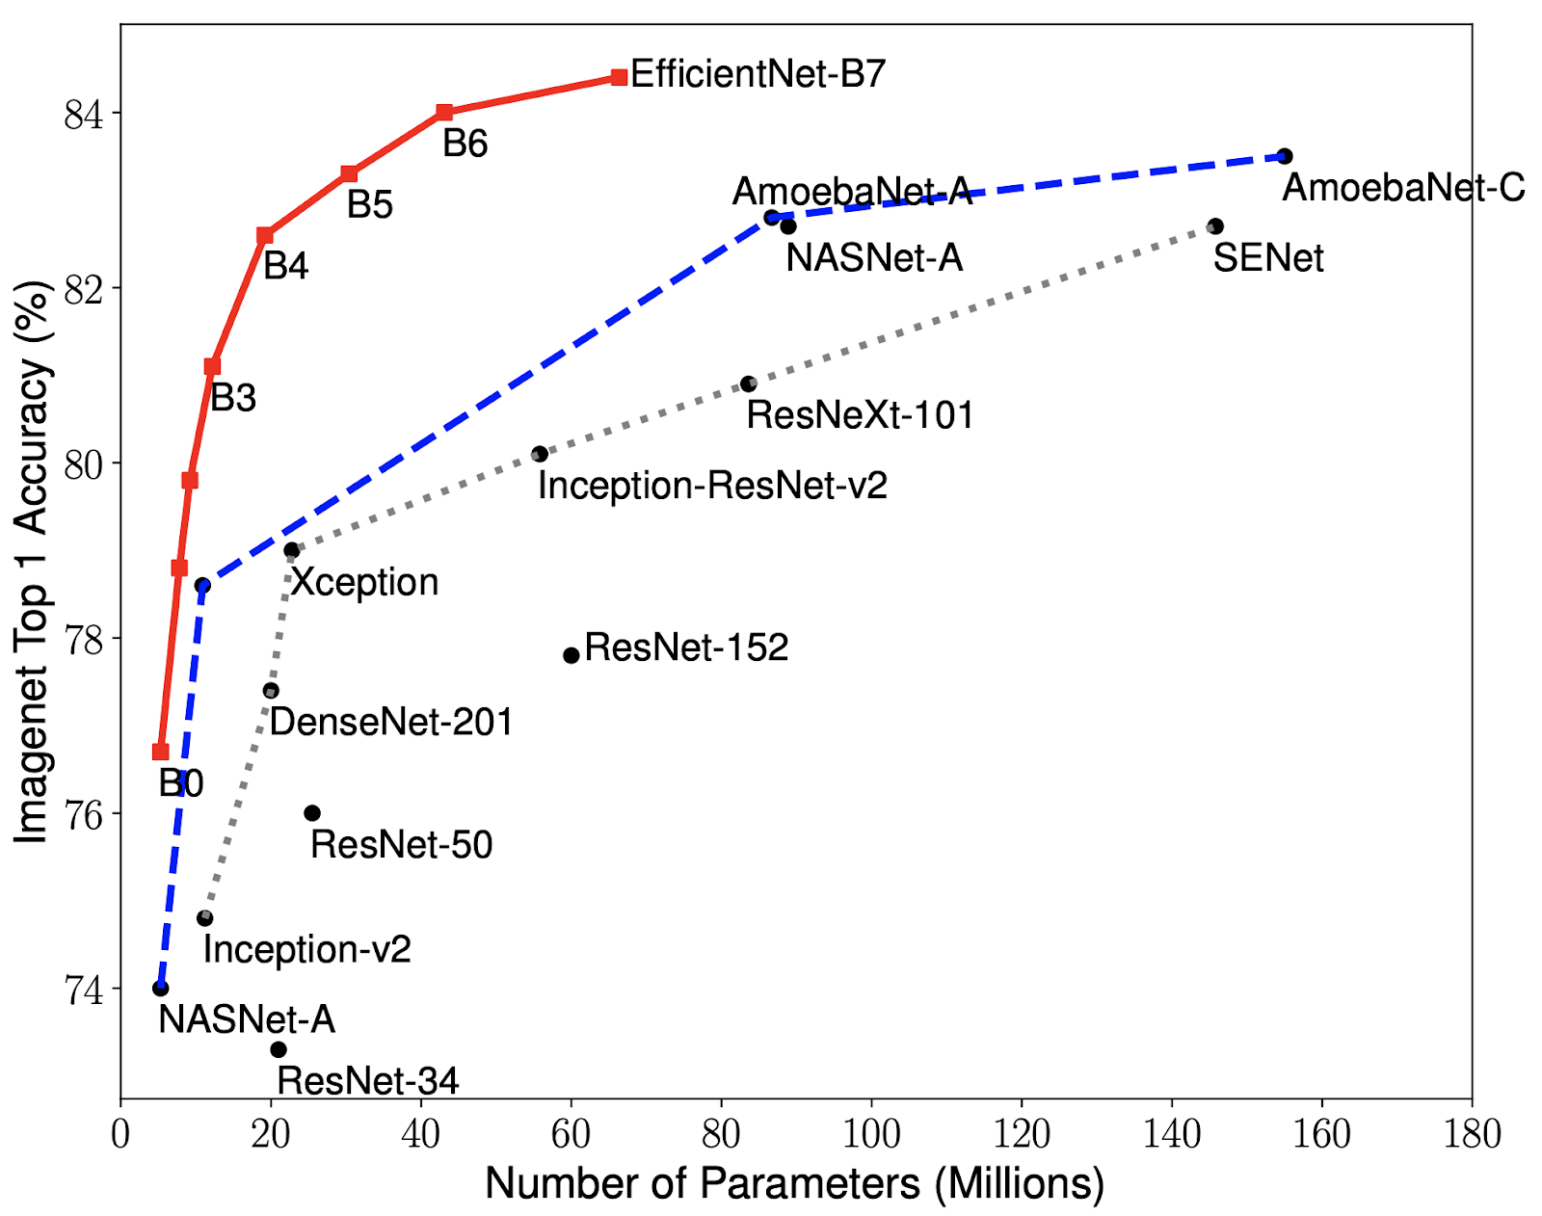

Slide 10
Some Popular Examples
YOLO
object detection
input: image, video output: bounding box
1
Stable Diffusion
image generation
input: text output: image
2
GPT3
generate text
input: text
output: text
3
Whisper
transcribe
input: audio
output: text
4

Slide 11
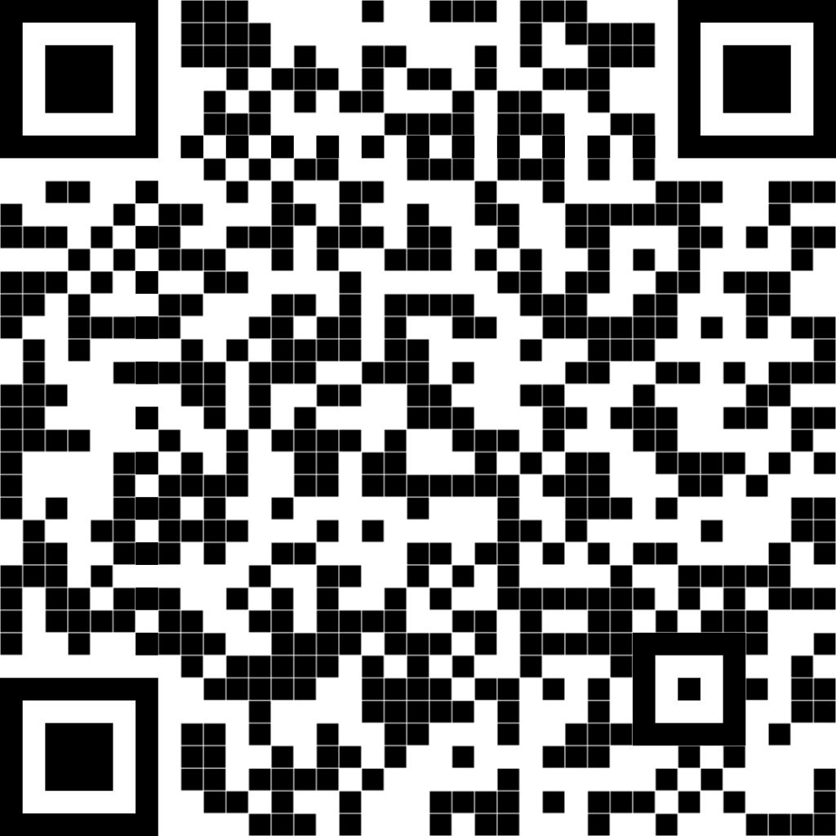
Try out the repository!

Slide 12




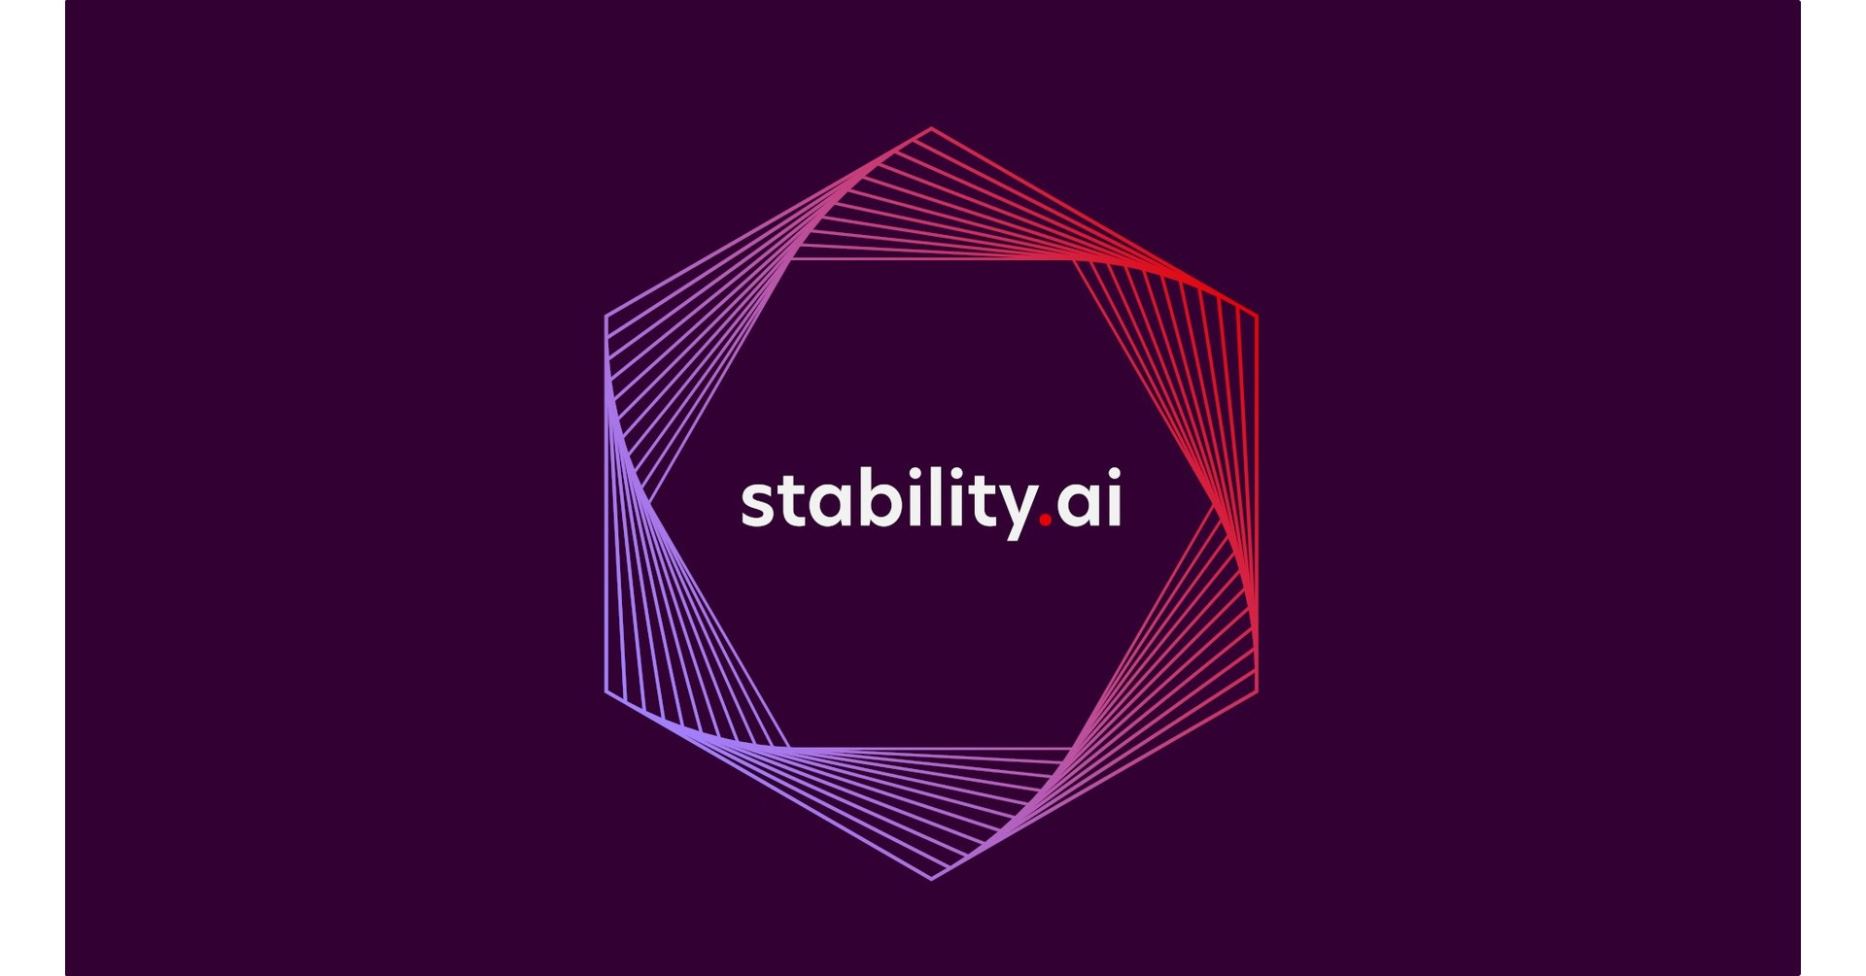
Organizations To Follow

Slide 13
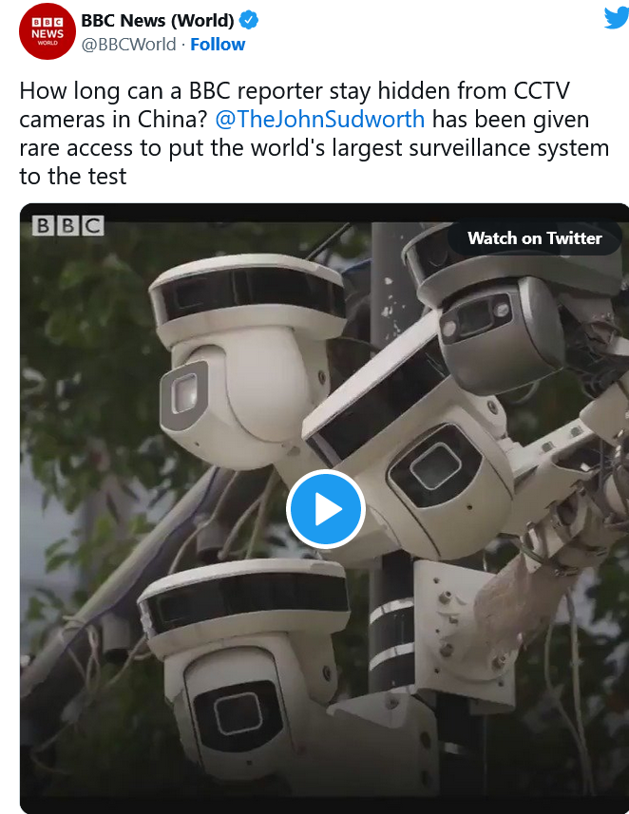

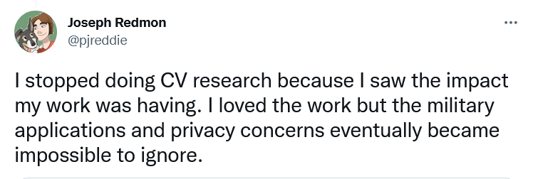
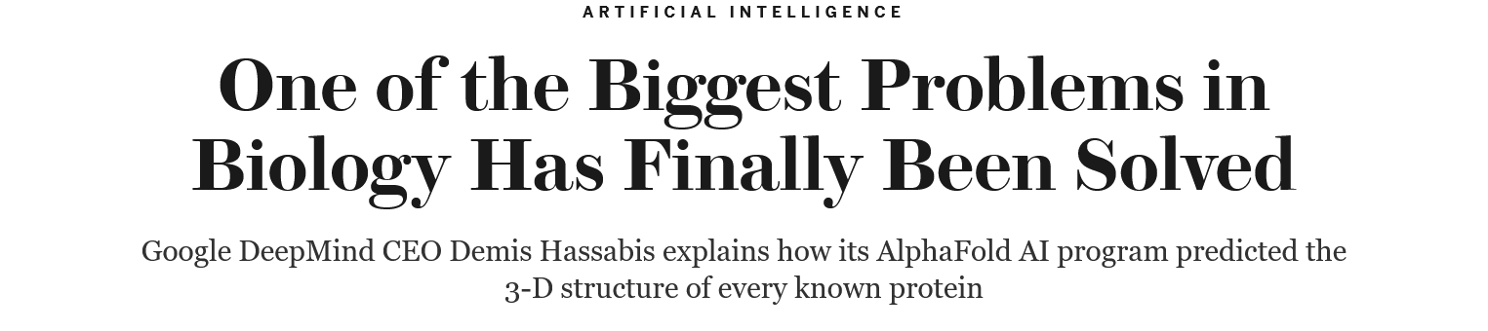

Thoughts?
Right now, our machines are like smart insects, eventually they will be as smart as mice. After that maybe as smart as dogs and cats. Probably by the end of the century, who knows, they will be as smart as monkeys.
Michio Kaku, Professor of Theoretical Physics, City College of New York.

Slide 14
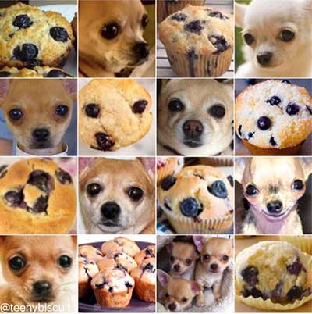
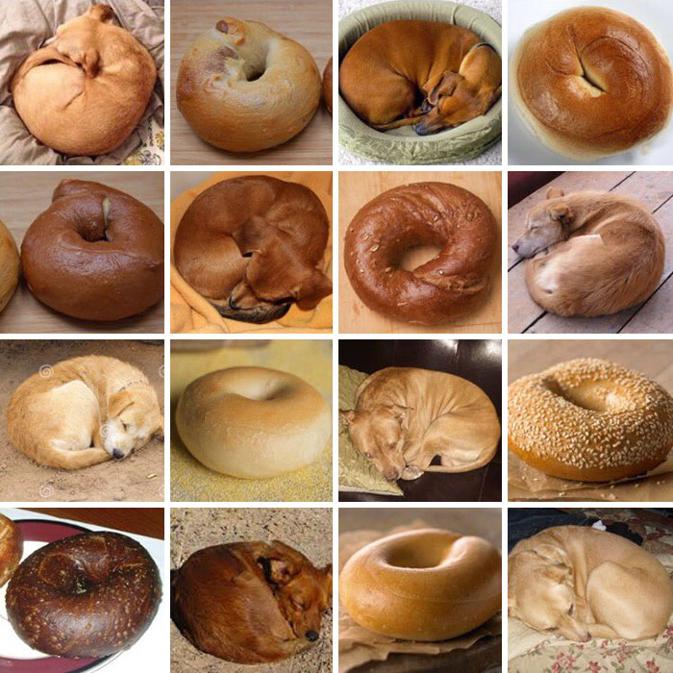
Not so fast!
Notes:
Fill the gap between human learning and machine intelligence…

Slide 15
How can I start AI research?
Youtube is #1 source for introductory concepts. Few tutorials are here 1, 2, 3.
Calculus, Linear Algebra and some Statistics !
Start Python. Here is #1 tutorial series.
Play with Pytorch!

